Slide 1
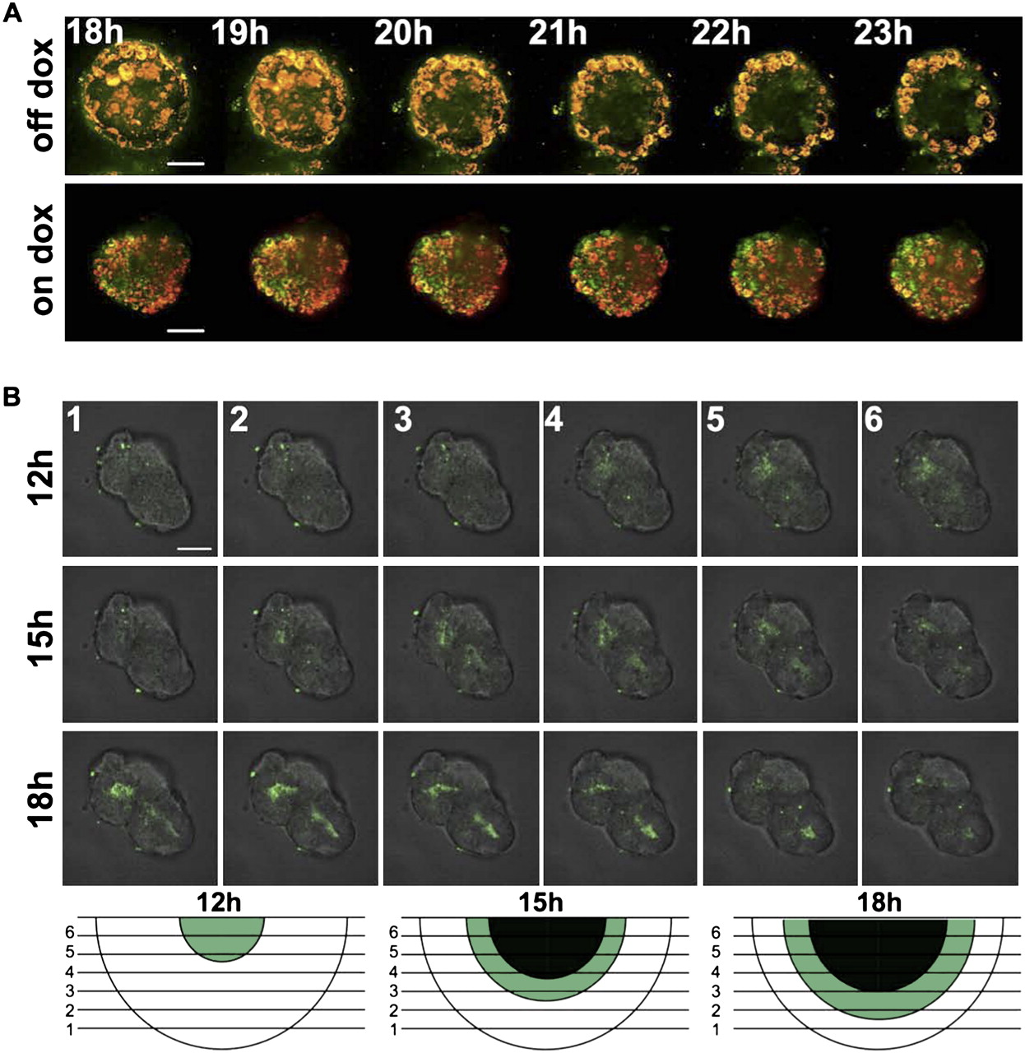

Following doxycycline withdrawal, internal cells lose mitochondrial polarity and undergo Caspase3-induced apoptosis.
Jechlinger M et al. Genes Dev. 2009;23:1677-1688
©2009 by Cold Spring Harbor Laboratory Press
Notes:
Following doxycycline withdrawal, internal cells lose mitochondrial polarity and undergo Caspase3-induced apoptosis. (A) Confocal images of tritransgenic acini grown in the presence of doxycycline for 5 d, then weaned from doxycycline and incubated in MitoProbe JC-1-solution for 1 h to assess for mitochondrial potential loss during doxycycline withdrawal. The JC-1 dye accumulates in the mitochondria of healthy cells as aggregates (fluorescent red) while the monomeric form in the cytoplasm fluoresces green (yellow overlay). Upon removal of doxycycline, the mitochondrial potential collapses and the JC-1 dye can no longer accumulate in the mitochondria, remains in the cytoplasm, and the red/green fluorescence intensity ratio is decreased. Projections (covering 10-μm depth) through the middle of a typical sphere. (Top panels) JC-1 signal at indicated time points after doxycycline withdrawal. (Bottom panels) JC-1 signal of a control sphere at indicated time points with doxycycline present in the growth media. Bar, 30 μm. (B) Confocal image of acini grown from tritransgenic cells incubated with NucView substrate for detecting caspase-3 activity within live cells in real time. Established acini were grown in the presence of doxycycline for 5 d and then weaned from doxycycline. Each row shows six adjacent projections (5-μm depth) that cover the region from the middle of a typical sphere (labeled 6) to the top of the sphere (labeled 1). Caspase-3 activity (green fluorescence) is superimposed on the bright-field picture. (Top panels) Caspase-3 activity at 12 h after doxycycline withdrawal is only seen in the center of layers 6 and 5. (Middle panels) Caspase3 activity at 15 h after doxycycline withdrawal is seen in the center of layers 6–3. (Bottom panels) Caspase-3 activity at 18 h after doxycycline withdrawal is seen in the center of layers 5–1. Graphic sketches depict the caspase3-activated regions for the three time point analyzed. Bar, 30 μm

